Slide 1
Noise Pollution
Monitoring

Slide 2
overview
The project involves setting up IoT devices with sensors
It refers to the systematic process of measuring,recording and assessing
Sound levels in various environment to understand the extent of noise
pollution and its potential impact on human health and the surrounding
ecosystem…System uses air sensors to sense presence of harmful gases
or compounds in the air and constantly transmit this data to micro controller…

Slide 3
Involving steps :
Device configuration with wowkit :
Start by signing up for a wowkit account…
Add IoT device :
In wowkit add your Iot devices..
Sensor Integration :
Connect your noise pollution monitoring sensor
Python script for data collection and wowkit integration :
Develop a python script that reads the data from the sensors
and send it to the wowkit platform….

Slide 4
Coding
Import pyaudio
Import numpy as np
FORMAT=pyaudio.paInt16
Format(16-bit PCM)
CHANNELS=1
Channels (1 for mono,2 for stereo)
RATE=44100
CHUNK=1024
Audio=puaudio.PyAudio()
Stream=audio.open(format=FORMAT,
channels = CHANNELS,
rate =RATE,
input =True,
Frames_per_buffer=CHUNK
Print(“Listening…”)
try:
while true:
Stream data=np.frombuffer(stream.read(CHUNK),
dtype=np.int(16)

Slide 5
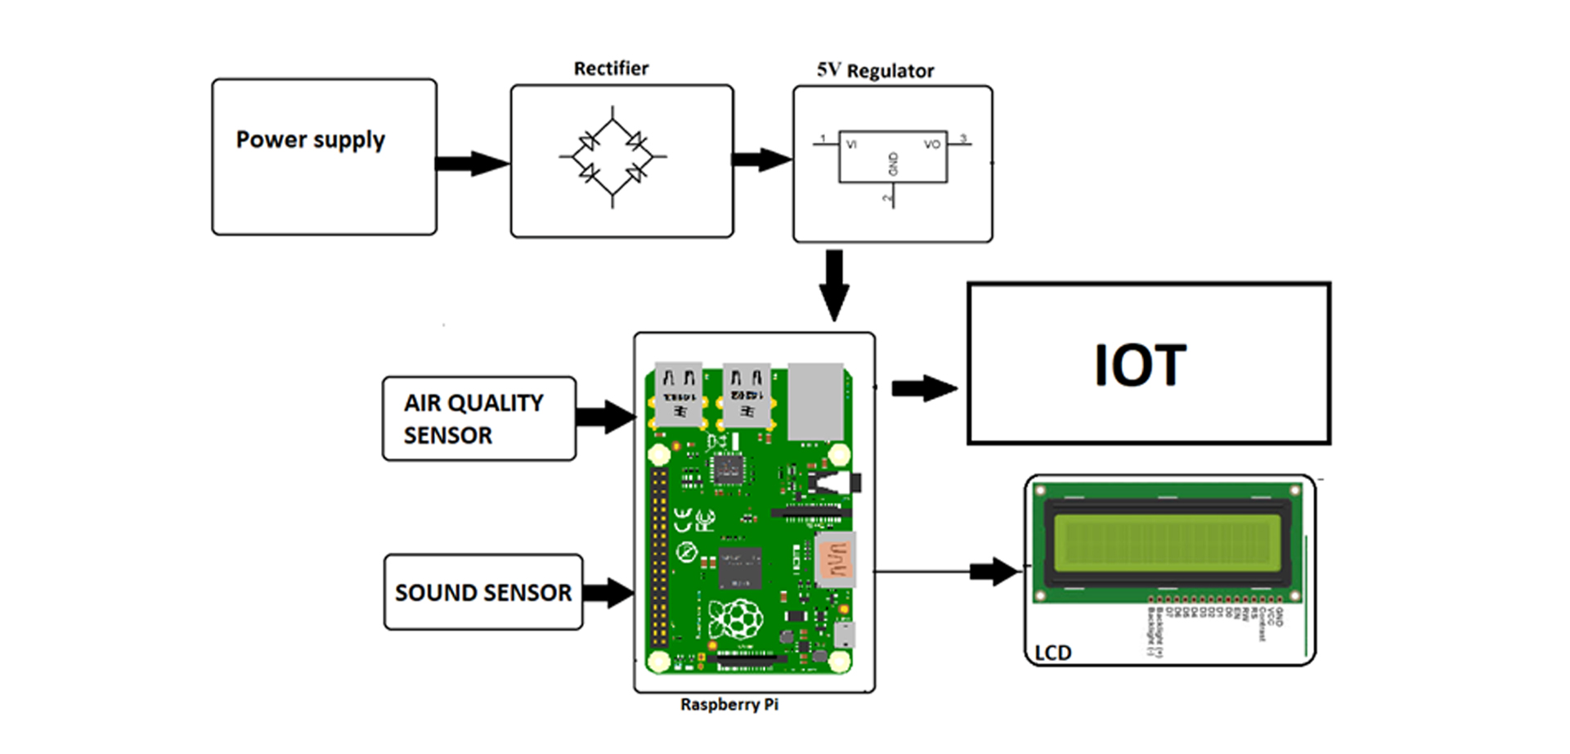
Connenction

Slide 6
After completing coding these steps
Testing :
Test the system to ensure it collect and sends data accurantly
to wowkit…
Data visualization and alerts :
Use the wowkit platform to setup data visualize tools and
configure alerts for noise pollution monitoring….

